Slide 1

The Art of Data Transformation
Imagine transforming raw data into insightful stories.
This presentation delves into two diverse datasets, uncovering hidden patterns and generating surprising insights.
Notes:
Good afternoon today we will explore how raw data, like RGB color values or musical emotions, can be transformed into meaningful insights that reveal human preferences and emotions. This journey highlights the art of data transformation, bridging the gap between numbers and human experience.

Slide 2
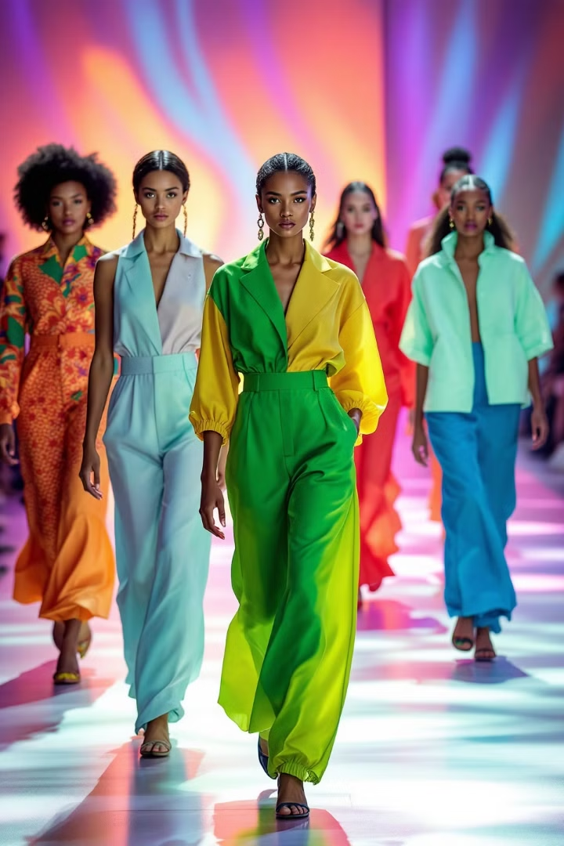



Fashion Data Journey
Initial Problem
We started with a dataset of 25,000 entries, each containing raw RGB values. This representation lacked a clear understanding of color harmony.
Our Process
To make the data more meaningful, we transformed RGB values into HLS color space. This allowed us to develop a harmony scoring system based on color theory principles, which evaluated the compatibility of different colors.
Key Discoveries
This process revealed interesting patterns in the data, such as a strong correlation between fair skin and summer color palettes. We also uncovered limitations within the dataset, particularly a bias toward fair skin tones.
Notes:
Our first challenge was fashion, where we began with 25,000 entries of RGB values—numbers that simply represented colors. At first, the data felt overwhelming and impersonal, but we turned to color theory, the science behind why certain colors complement each other, to guide our analysis. Through careful transformation, we uncovered intriguing patterns, such as a strong link between skin tones and seasonal color palettes, helping us understand how colors can enhance personal style.

Slide 3
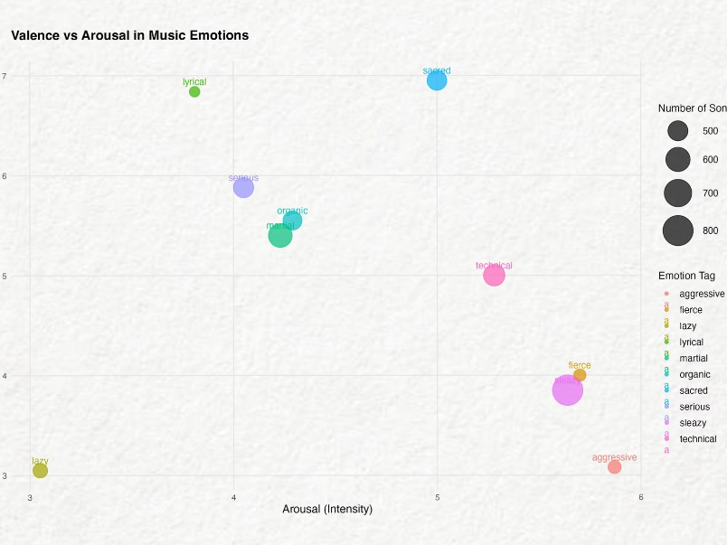
The Music Evolution
1
Emotional Fingerprints
2
Artists Shape Emotions
3
Emotional Overlaps
90,001 songs analyzed through 2D scatter plots.
Artists have a stronger influence than genres.
Artists with unique emotional expression.
Basic regression proved insufficient to capture the full range of musical emotions. This led to a shift in perspective, where 2D scatter plots were used to analyze the emotional landscape of a dataset of 90,001 songs.
Notes:
Our second challenge was quantifying emotions in music using a dataset of over 90,000 songs. By moving beyond basic regression to 2D scatter plots, we uncovered that artists, rather than genres, were the primary drivers of emotional impact and identified artists who skillfully bridged opposing emotional territories.

Slide 4
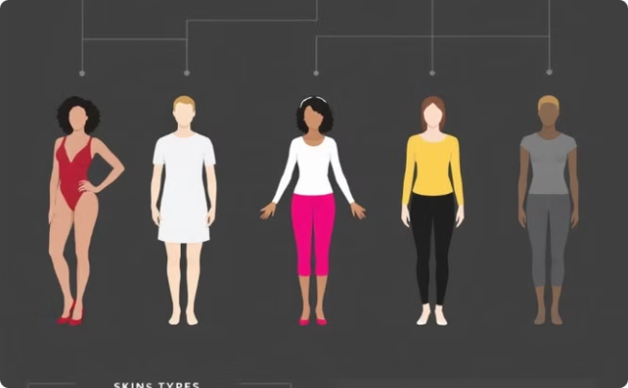
Fashion Dataset Overview
Profile of Body Metrics and Fashion Colors
The dataset features 25,000 entries, analyzing relationships between body metrics, skin color, and clothing color compatibility.
Height
Weight
Skin Color
Shirt Color (RGB)
Trouser Color (RGB)
Notes:
"Let's dive deeper into our fashion dataset. We worked with 25,000 entries exploring relationships between body metrics, skin color, and clothing color compatibility. Our variables included seven key features: height, weight, skin color, and RGB values for shirt and trouser colors. Our objective was ambitious but focused: determine an individual's seasonal palette based on their skin tone and calculate a harmony score that could predict how well certain colors would work together."

Slide 5

Music Dataset Overview
Size
Variables
Objective
The MuSe dataset comprises 90,001 songs.
Each song in MuSe is characterized by 10 features.
The MuSe dataset aims to quantify music's emotional influence.
This comprehensive dataset allows for robust analysis of musical sentiment.
These features include song track, artist, emotion tags, and sentiment scores.
By analyzing the dataset, we can predict overall emotion scores of music.
Notes:
The Musical Sentiment Dataset, or MuSe, presented a different kind of complexity. With 90,001 songs characterized by valence, arousal, and dominance, we had ten distinct features to work with, including track information, artist details, emotion tags, and sentiment scores. Our goal was to quantify music's emotional influence and predict overall emotion scores - essentially creating a mathematical model for something as subjective as musical feeling.

Slide 6
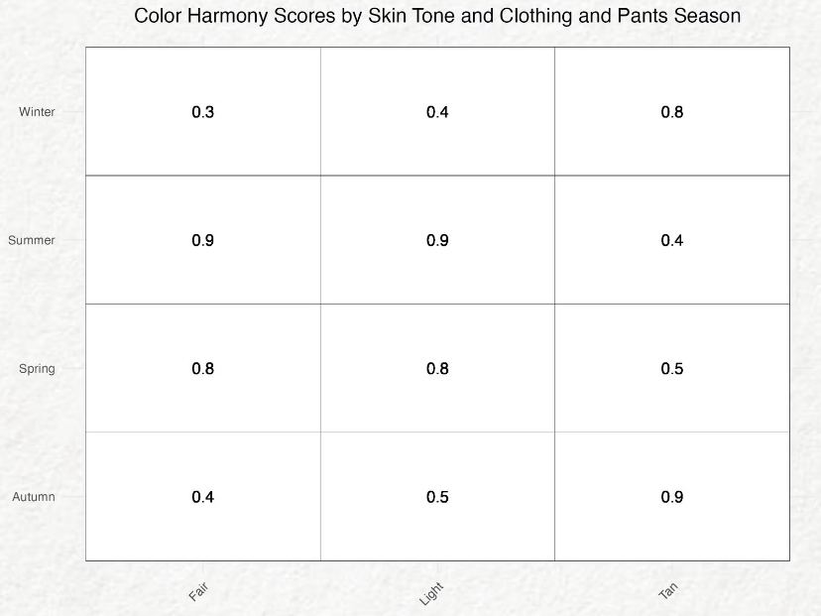
Fashion Dataset Transformation
1
RGB to HLS Conversion
2
Skin Tone Categorization
3
Seasonal Palette Assignment
Transforms raw RGB values into more intuitive Hue, Lightness, Saturation (HLS) color space.
Classifies skin tones into Fair, Light, Medium, and Tan based on lightness values.
Organizes clothing colors into Spring, Summer, Autumn, and Winter palettes using hue and lightness.
4
Harmony Score Calculation
Develops a scoring system to quantify compatibility between skin tones and seasonal palettes.
These transformations unlock valuable insights into the relationship between color, personal style, and seasonality.
Notes:
The transformation of the fashion dataset involved four key steps: converting RGB values to the HLS color space for better alignment with human perception, classifying skin tones into Fair, Light, Medium, and Tan categories, organizing clothing colors into seasonal palettes (Spring, Summer, Autumn, Winter) based on hue and lightness, and creating a scoring system to quantify the compatibility between skin tones and seasonal palettes, transforming subjective color harmony into measurable data. " Now that we understand the foundations of our datasets and transformation processes, Arthur will walk us through our key findings and their practical applications."

Slide 7
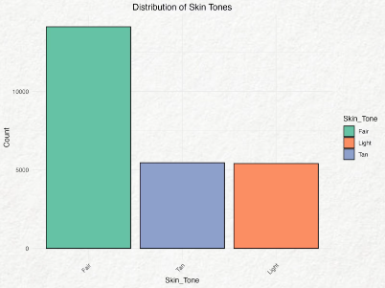
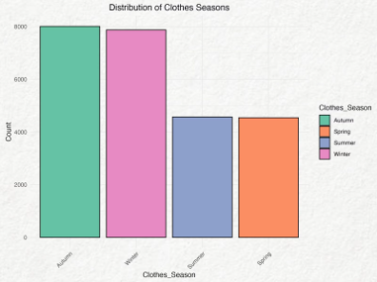
Fashion Dataset Findings
Our analysis revealed fascinating insights from the Fashion dataset.
We observed strong correlations between skin tones and color palettes.
Dataset imbalances presented challenges for model training.
Skin Tone
Palette
Score
Fair
Summer
0.9
Tan
Autumn
High
Skin Tone
Samples
Fair
12,272
Light
4,655
Tan
4,743
Notes:
Our analysis revealed fascinating patterns in how skin tones interact with seasonal color palettes. Fair skin tones showed particularly high harmony with Summer palettes, scoring 0.9 on our harmony scale. Tan skin tones demonstrated stronger compatibility with Autumn palettes. However, we also uncovered significant dataset imbalances: Fair skin tones were heavily overrepresented with 12,272 samples, compared to just 4,655 for Light and 4,743 for Tan skin tones.

Slide 8

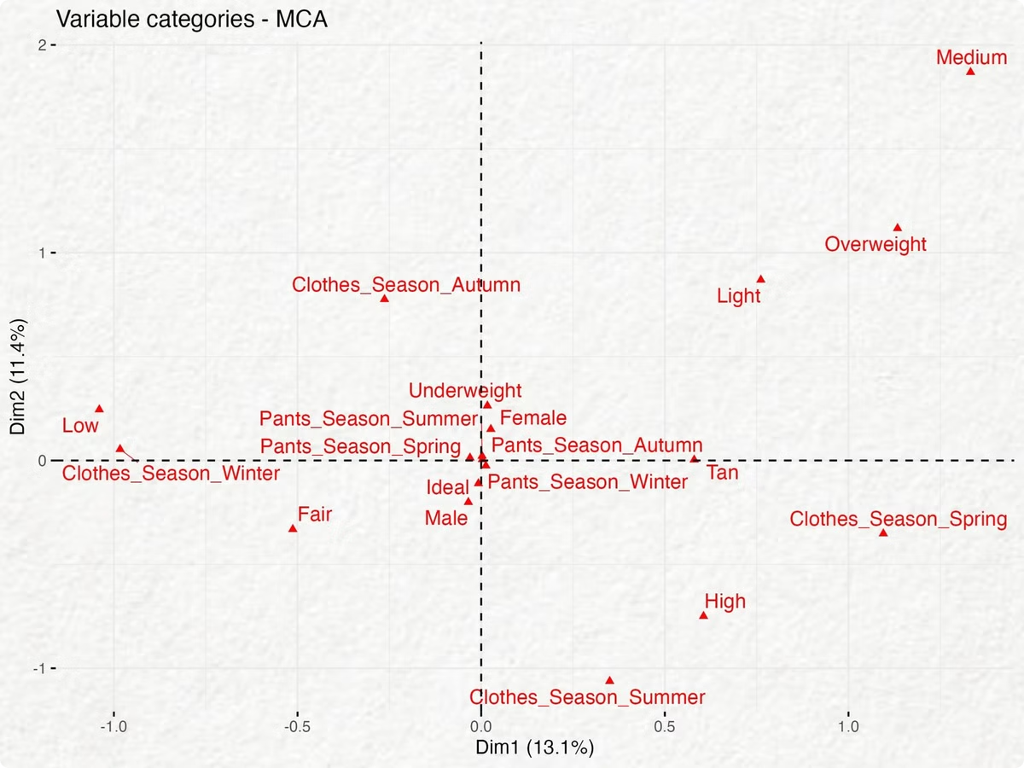
Multiple Correspondence Analysis (MCA) Insights
MCA reveals the underlying relationships between fashion items and their associated attributes.
It unveils hidden patterns in data, like the interplay between clothing styles and their target demographics.
This technique uncovers valuable insights into consumer preferences and trends.
These insights inform strategic decisions for product development and marketing.
Notes:
"Using Multiple Correspondence Analysis, we discovered complex relationships between various factors in our fashion dataset. This visualization shows how different variables cluster together. Notice how certain skin tones gravitate toward particular seasonal palettes, creating distinct groupings in the data. The distance between points represents their relationship strength - closer points indicate stronger associations. This analysis helped us understand not just individual correlations, but the entire network of relationships between body metrics, gender, skin tones, and color preferences."

Slide 9





Fashion Practical Applications
Personalized Recommendations
Retail Strategy
Inform inventory decisions based on skin tone and color harmony patterns.
Tailored suggestions for individual style preferences and body types.
Data-driven approach for matching skin tones with optimal seasonal palettes.
AI-Driven Styling
Diversity Awareness
Framework for developing intelligent fashion recommendation systems.
Highlight potential biases in fashion data collection and representation.
Notes:
"These findings have four key practical applications. First, we can now offer personalized recommendations based on scientific analysis rather than just tradition or intuition. Second, retailers can use this data to inform inventory decisions, ensuring they stock colors that work well for their customer base. Third, this provides a framework for developing AI-driven styling systems. Finally, and perhaps most importantly, our analysis highlights the need for greater diversity awareness in fashion data collection and representation."

Slide 10

Music Data Transformation
1
Sample Selection
Due to computational constraints, we selected a sample of 5,000 songs, a representative subset of the vast musical landscape.
2
Data Restructuring
We assigned numerical IDs to artists and genres for efficient analysis and modeling.
3
New Variable
We introduced a mean emotions score, capturing the average of valence, arousal, and dominance, to provide a comprehensive measure of emotional impact.
4
Regression Models
We developed both univariate and multivariate regression models to predict the emotional impact of music, analyzing the relationship between musical features and emotions.
Notes:
"For the music dataset, our transformation process was equally methodical. We started by selecting 5,000 songs from our larger dataset due to computational constraints. We then restructured the data by creating numerical IDs for artists and genres. A key innovation was the introduction of a mean emotions score, averaging valence, arousal, and dominance. Finally, we developed both univariate and multivariate regression models to predict emotional impact."

Slide 11
Music Dataset Findings
20%
75%
0.80
Genre
Artist
R-Squared
Only 20% of the variance in mean emotional impact can be explained by genre alone.
Artists have a much stronger influence on emotional impact, explaining 75% of the variance.
Individual models for valence and dominance achieved an R-squared of 0.80, demonstrating a high level of prediction accuracy.
Notes:
"The numbers tell a compelling story. Using genre alone as a predictor of emotional response yielded an R-squared value of just 20%. However, when we used artist as the predictor, this jumped to 75% - a dramatic improvement. Individual models predicting valence and dominance achieved R-squared values of 0.80, suggesting strong predictive power. These findings challenge our assumptions about how musical emotions are conveyed and received." With these analytical insights in mind, Isaia will show us how they translate into real-world applications and future opportunities.

Slide 12

Emotional Dimensions of Music
1
Valence
2
Arousal
3
Emotion Tags
Valence measures how positive or negative an emotion is.
Arousal measures how stimulating or exciting an emotion is.
Emotion tags describe the overall
feeling of a piece of music.
Notes:
"Looking at specific emotional dimensions, we found fascinating patterns. 'Sleazy' appeared in 812 songs with medium valence but high arousal. 'Martial' appeared in 583 songs, typically showing low valence but high arousal. 'Sacred' songs demonstrated high valence (6.95) with medium arousal (5.0), while 'Aggressive' tracks showed low valence (3.08) but high arousal (5.87). These patterns reveal how different emotional qualities manifest in measurable ways across musical compositions."

Slide 13
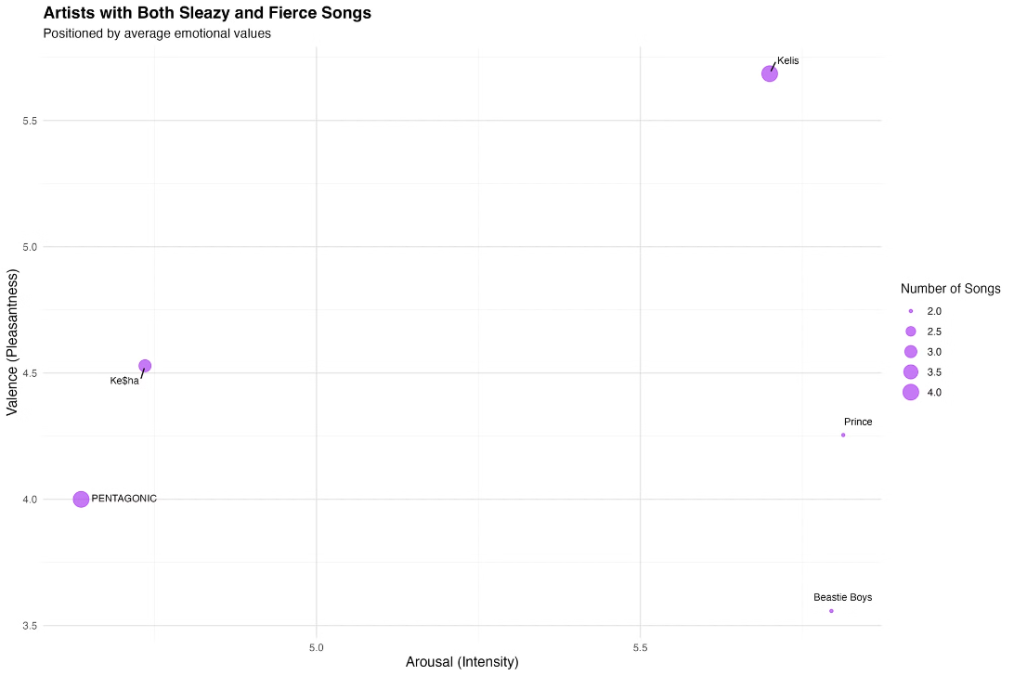
Artists Mastering Emotional Range
Analyzing artists' emotional range through musical characteristics can reveal their artistry. Our dataset includes a diverse selection of artists, allowing for a comprehensive analysis of different musical styles and emotional expression. By uncovering these patterns, we can better understand how musical choices affect emotional response.
Notes:
"Let's examine some artists who demonstrated exceptional emotional range in their music. Our scatter plot reveals something fascinating about how artists navigate different emotional territories. Look at this clustering pattern - it shows artists who successfully created both 'sleazy' and 'fierce' music, two seemingly opposite emotional spaces. What's particularly interesting is how these points distribute across both the valence and arousal axes, suggesting these artists aren't just jumping between emotions, but carefully crafting distinct emotional experiences in their music."

Slide 14



Artists Mastering Emotional Range
Kelis
PENTAGONIC
Ke$ha
Demonstrates exceptional range through high valence and arousal, particularly evident in her 'sleazy' and 'fierce' tracks that showcase her dynamic performance style.
Shows remarkable versatility in navigating diverse emotional spaces, creating a rich tapestry of musical expressions across their repertoire.
Exhibits distinctive patterns in emotional expression, crafting a unique artistic signature through her varied musical approaches.
Notes:
"Three artists particularly stood out in our analysis. Kelis maintained remarkably high scores in both valence (5.69) and arousal (5.70) across different emotional territories, showing consistent energy while spanning various moods. PENTAGONIC demonstrated impressive versatility, successfully navigating between 'sleazy' and 'fierce' emotional spaces while maintaining their distinctive sound. Ke$ha showed particularly interesting patterns in how she traverses emotional spaces, creating unique emotional fingerprints within her music that set her apart from other artists in our dataset."

Slide 15

Future Research Directions
Fashion
Music
Develop sophisticated color harmony algorithms. Investigate cultural differences in color preferences. Explore the impact of fabric textures on color perception.
Analyze lyrics alongside audio features. Study the evolution of an artist's emotional range over time. Investigate cross-cultural emotional responses to music.
Cross-Domain
Explore connections between music preferences and fashion choices. Develop AI models that integrate visual and auditory emotional cues.
Notes:
"Looking ahead, we see three promising research directions. In fashion, we need to develop more sophisticated color harmony algorithms and investigate how cultural differences influence color preferences. For music, we should analyze lyrics alongside audio features and study how artists' emotional range evolves over time. Perhaps most excitingly, we can explore cross-domain connections - imagine understanding how music preferences might influence fashion choices, or developing AI models that can integrate both visual and auditory emotional cues."

Slide 16

Conclusion: Bridging Data and Human Experience
Data transformation reveals hidden patterns within human perceptions. By converting subjective experiences into quantifiable data, we gain a deeper understanding of these experiences.
Our studies demonstrate the effectiveness of this approach. In fashion, we discovered correlations between skin tones and color palettes. In music, we uncovered artists' unique emotional signatures. These findings open new avenues for exploration.
Notes:
"As we conclude, let's reflect on what these two studies reveal about the relationship between data and human experience. In both cases, we succeeded in quantifying deeply subjective human perceptions into measurable metrics - whether mapping skin tones to seasonal palettes or quantifying emotional responses to music through valence, arousal, and dominance. The patterns we uncovered bridge the gap between individual preference and systematic understanding. This work shows that while human experiences like fashion choices and musical appreciation may feel purely subjective, they follow patterns we can understand and even predict through careful data transformation and analysis. Thank you for your attention. Are there any questions?"

